Slide 1
Project Title ✍️ Measuring The Pulse Of prosperity :An Index of Economic Freedom.

Slide 2
Group Members Name
1 . G.Atchaya.
2. S.Mayavathi.
3. S.Salomi.
4. M.Jayanthi.

Slide 3
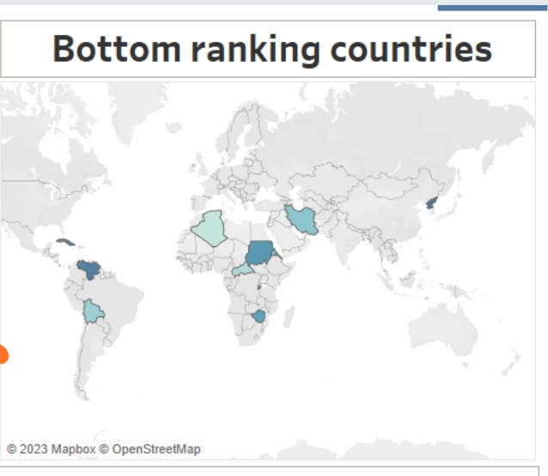

Slide 4
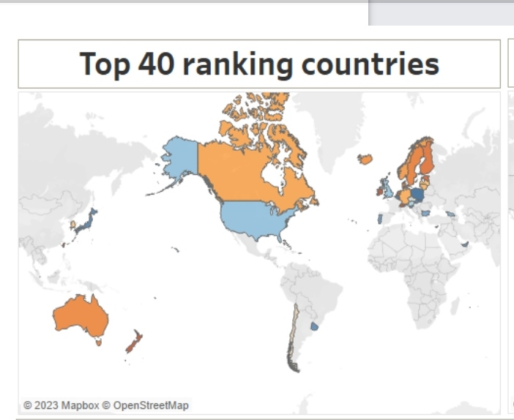

Slide 5
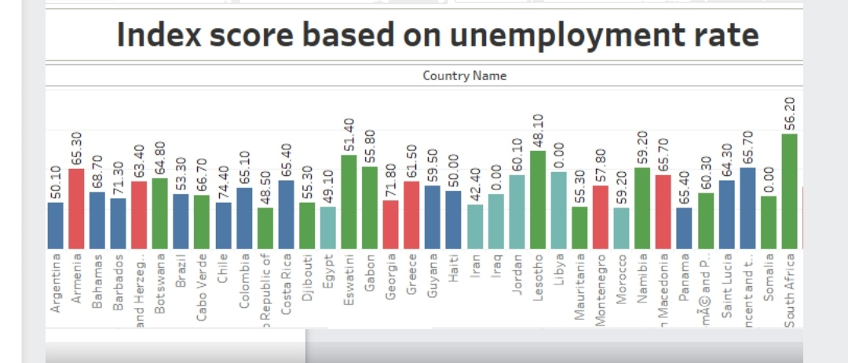

Slide 6
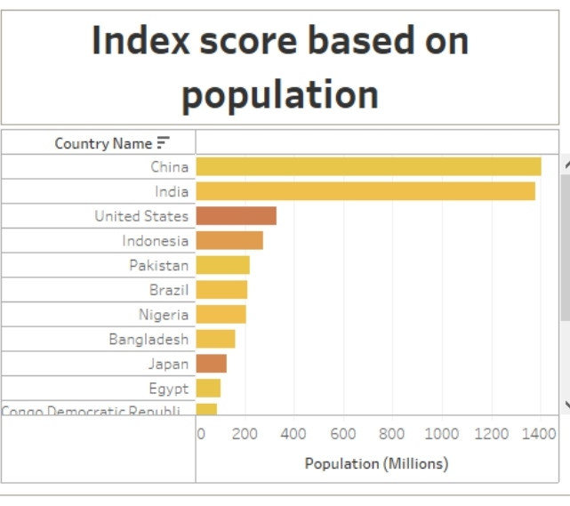

Slide 7
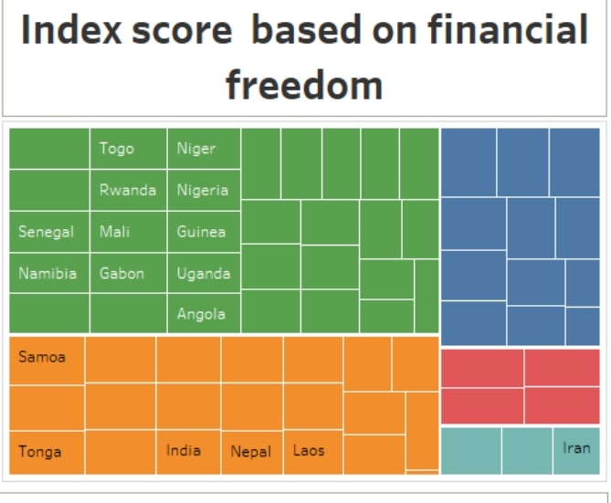

Slide 8
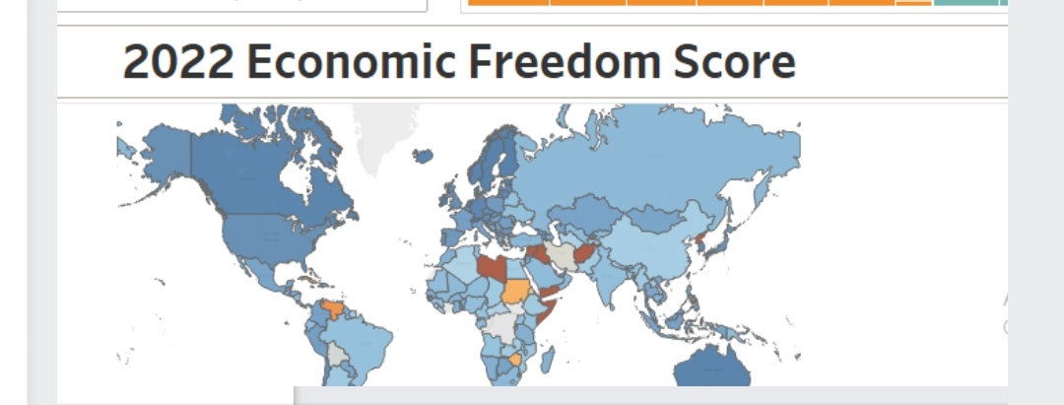

Slide 9
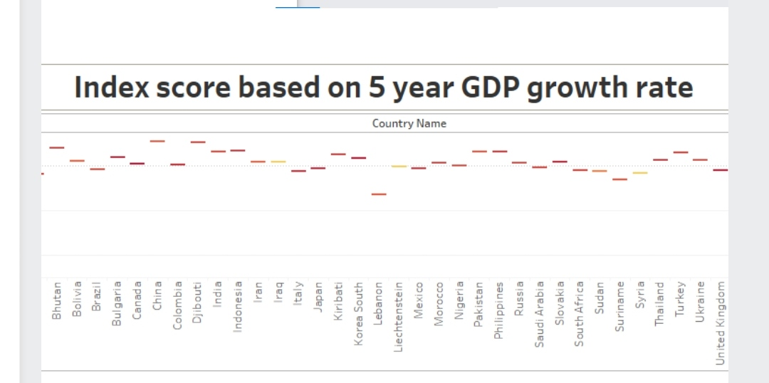

Slide 10
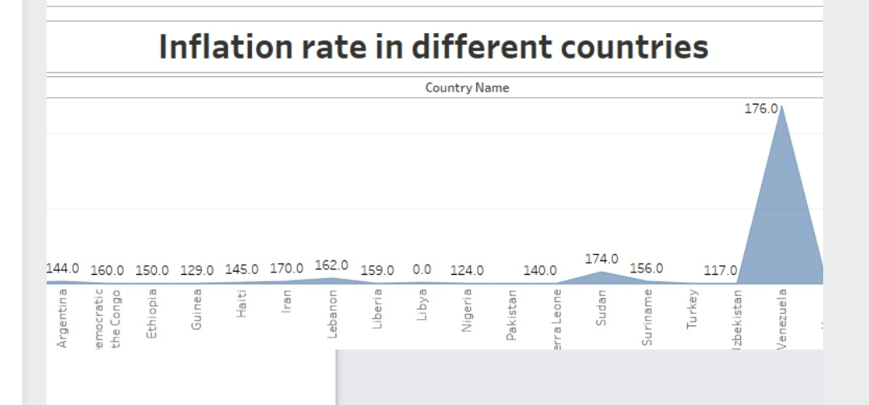

Slide 11
Finally...
Thank you ......

